Slide 1

PYTHON
PRESENTATION
HOME
ABOUT
CONTENT
OTHERS
PYTHON PROGRAMMING LANGUAGE
GET STARTED
PYTHON PROGRAMMING LANGUAGE - YOUR GATEWAY TO MODERN DEVELOPMENT

Slide 2
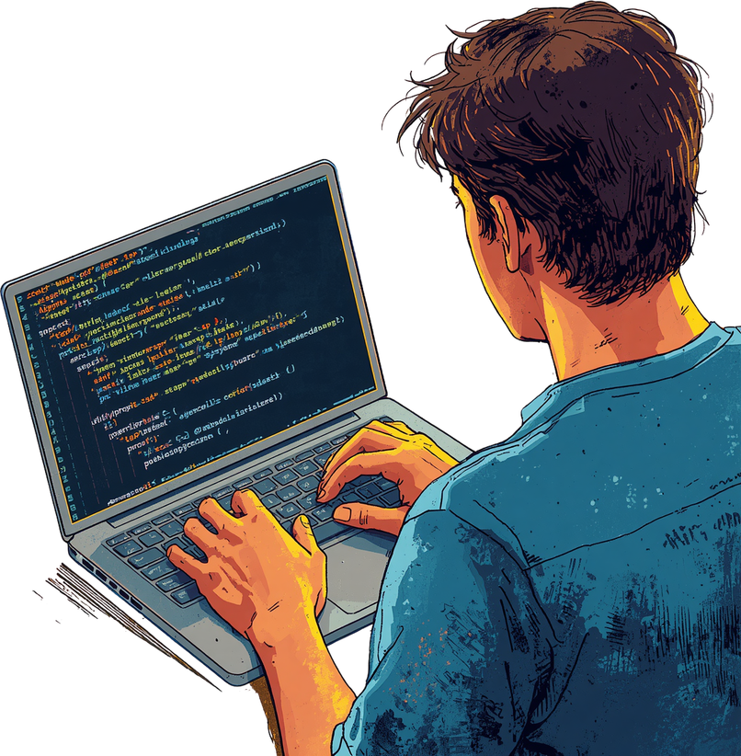
PYTHON
PROGRAMMING
HOME
ABOUT
CONTENT
OTHERS
Objective of Session
What is python?
Understanding programming language levels.
The origins of python.
Python version.
Why is python popular?
Popular applications of python.
Summary.
NEXT SLIDE

Slide 3
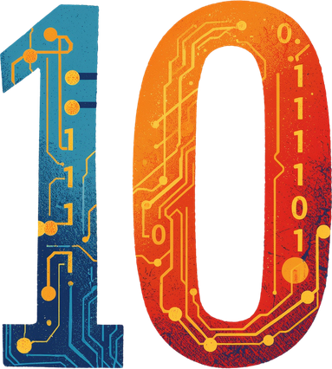
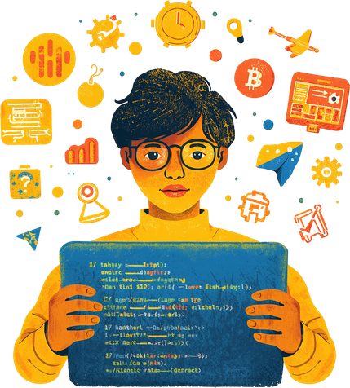
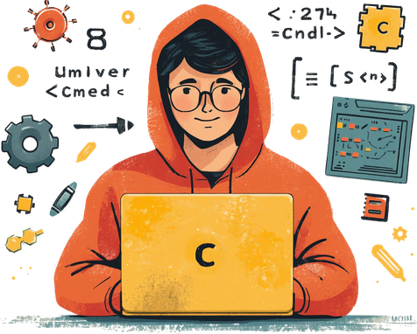
PYTHON
PRESENTATION
HOME
ABOUT
LEVELS
MORE
Understanding Programming Language Levels
Programming languages are categorized into three levels based on their abstraction from hardware. Understanding these levels helps explain why Python is designed the way it is.
NEXT SLIDE

Slide 4
PYTHON
PROGRAMMING
HOME
ABOUT
CONTENT
OTHERS
What is Python?
Python is a high-level, general-purpose programming language known for its simplicity and readability. Its clean syntax makes it easy to learn and write, allowing developers to focus on solving problems rather than complex code. Python is versatile and used for web development, data analysis, AI, and more.
NEXT SLIDE

Slide 5
PYTHON
PROGRAMMING
HOME
ABOUT
CONTENT
OTHERS
Level of Languages
1. High-Level Language (HLL)
High-level languages are designed to be easily read, written, and maintained by humans.
They use natural language elements (mostly English) and abstract away the complex details of the computer's hardware, such as memory management and CPU registers.
Key Characteristics:
Highly readable and programmer-friendly.
Platform-independent: Code written on one machine can run on another with little to no modification.
Requires a compiler or an interpreter to translate the code into machine-readable format.
Slower execution speed compared to lower-level languages because of the layers of abstraction.
Examples: Python, Java, JavaScript, C#, Ruby.
Best Used For: Web development, data science, mobile apps, enterprise software, and AI.
NEXT SLIDE

Slide 6
PYTHON
PROGRAMMING
HOME
ABOUT
CONTENT
OTHERS
2. Low-Level Language (LLL)
Low-level languages are closely tied to the computer's physical hardware and architecture. They provide little to no abstraction from the computer's instructional set.
Low-level languages are further split into two types:
Machine Language (Binary): The absolute lowest level, consisting entirely of 0s and 1s. This is the only language a CPU understands natively. It is nearly impossible for humans to write or debug efficiently.
Assembly Language: A step above machine code. It replaces binary strings with short text commands called mnemonics (like MOV, ADD, PUSH). It requires an assembler to convert it directly into machine code.
Key Characteristics:
Platform-dependent: Code written for one specific processor architecture (like x86) will not run on another (like ARM).
Extremely fast and memory-efficient.
Gives the programmer direct control over hardware, memory addresses, and CPU registers.
Examples: Machine Code, x86 Assembly, ARM Assembly.
Best Used For: Writing operating system kernels, device drivers, firmware, and real-time simulation systems where execution speed is critical.
NEXT SLIDE

Slide 7
PYTHON
PROGRAMMING
HOME
ABOUT
CONTENT
OTHERS
Level of Languages
3. Mid-Level Language (Intermediate)
"Mid-level" is not a strictly standardized formal definition, but it is a widely accepted term for languages that bridge the gap between high-level and low-level programming. They offer the syntax, readability, and structure of a high-level language, but retain the ability to directly manipulate hardware and memory like a low-level language.
Key Characteristics:
Supports high-level features like functions, modules, and complex data types.
Supports low-level features like pointers, which allow direct access to memory addresses.
Strikes a balance between execution speed and development speed.
Examples: C and C++ are the definitive examples of mid-level languages.
Best Used For: Developing operating systems (like Linux/Windows), game engines, embedded systems, and high-performance applications.
NEXT SLIDE

Slide 8
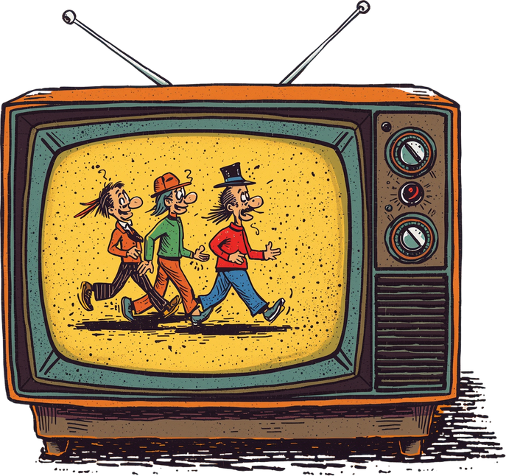

PYTHON
PRESENTATION
HOME
ABOUT
CONTENT
OTHERS
The origins of Python
Python was developed by Guido van Rossum in the early 1990s in the Netherlands. The name "Python" was inspired by the British comedy series "Monty Python's Flying Circus" — not the snake. Van Rossum wanted a short, unique name that was fun and memorable.
NEXT SLIDE

Slide 9

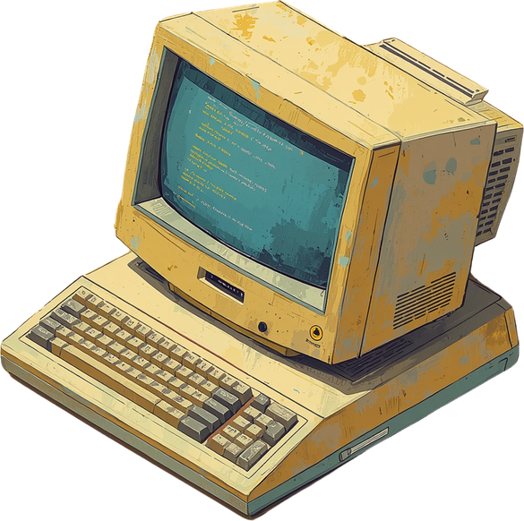
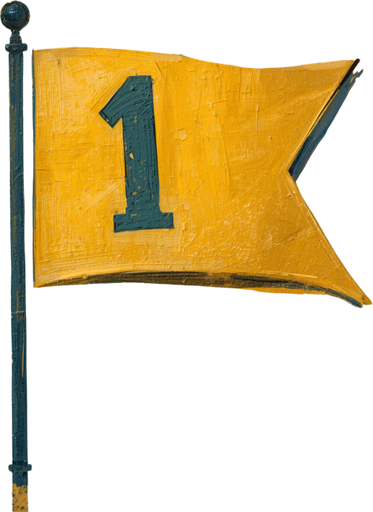
PYTHON
PRESENTATION
HOME
ABOUT
TIMELINE
OTHERS
Released in 1994, Python Version 1 marked the official birth of the language. It introduced core features including exception handling, functions, and the core data types that would define Python's elegant simplicity.
Python Version 1

Slide 10

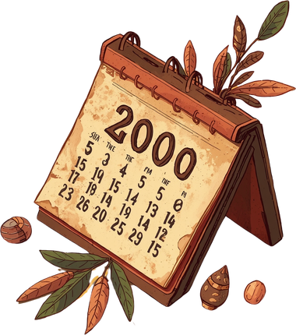
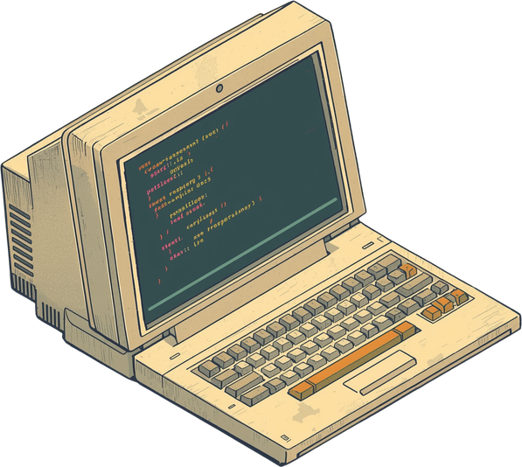
PYTHON
PRESENTATION
HOME
ABOUT
TIMELINE
MORE
Python 2 was released in 2000, introducing significant new features including list comprehensions, garbage collection, and Unicode support. It became widely adopted across industries and remained the standard for many years before being deprecated in 2020.
Python Version 2 (2000)

Slide 11


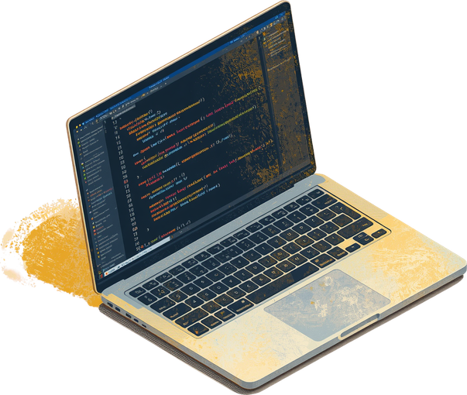
PYTHON
PRESENTATION
HOME
ABOUT
TIMELINE
7/11
Python Version 3 (2008)
Python 3 was released in 2008 as a major milestone. It introduced significant changes that made it not backward compatible with Python 2. Today, Python 3 is the modern standard with ongoing support and active development.

Slide 12
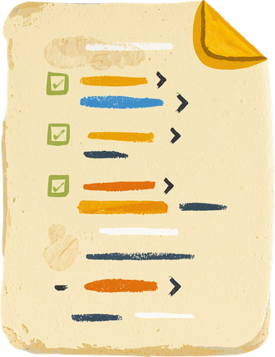

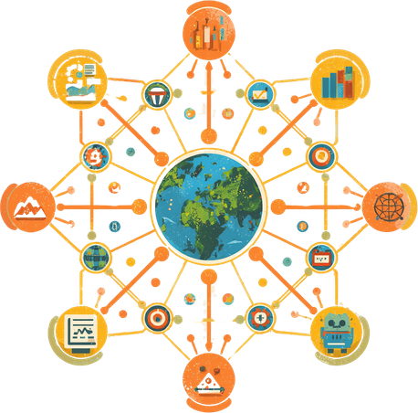
PYTHON
PRESENTATION
HOME
ABOUT
CONTENT
OTHERS
Python's popularity stems from its simple, readable syntax that beginners love. Its vast standard library and active community provide endless resources. Plus, it's versatile across web, AI, data science, and more.
Why is Python Popular?
NEXT SLIDE

Slide 13

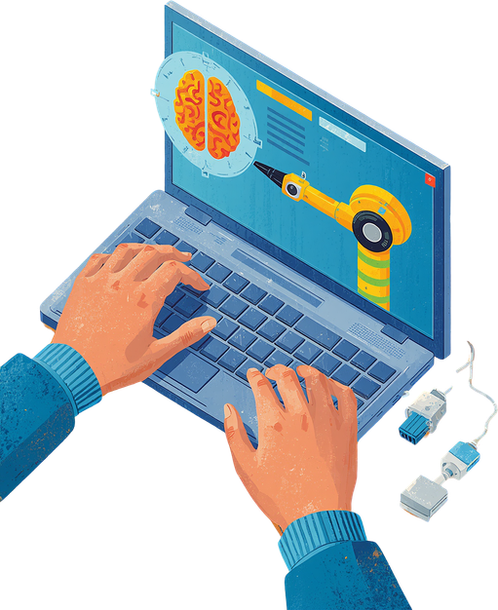
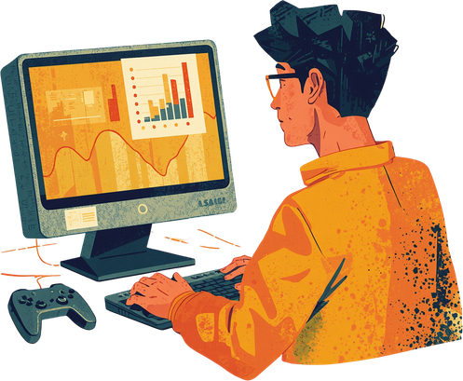
PYTHON
APPLICATIONS
HOME
ABOUT
CONTENT
OTHERS
Popular Applications Of Python
1. Data Science and Analytics
Python is the undisputed king of data science. Its clear syntax allows data analysts and scientists to clean, manipulate, and analyze massive datasets without getting bogged down by complex code.
Key Libraries: Pandas (for data manipulation), NumPy (for numerical computing).
2. Machine Learning and Artificial Intelligence (AI)
Because of its flexibility and robust community support, Python is the primary language used to build AI systems, predictive models, and deep learning algorithms.
Key Libraries: Scikit-Learn, TensorFlow, PyTorch.

Slide 14
PYTHON
APPLICATIONS
HOME
ABOUT
CONTENT
OTHERS
Popular Applications of Python
3. Data Visualization
Python makes it easy to turn raw, complex data into visual, easy-to-understand charts, graphs, and dashboards for business intelligence.
Key Libraries: Matplotlib, Seaborn, Plotly.
4. Automation and Scripting
If a task is repetitive, Python can probably automate it. "Scripting" refers to writing short programs to automate simple daily tasks.
Use Case: Automating Excel report generation, renaming thousands of files at once, scraping data from websites (using BeautifulSoup or Scrapy), or sending automated email alerts

Slide 15
PYTHON
APPLICATIONS
HOME
ABOUT
CONTENT
OTHERS
Popular Applications of Python
5. Software Testing and Prototyping
Python is widely used in Software Quality Assurance (QA) to catch bugs and ensure applications work smoothly before launch. Because it is so fast to write, developers also use it to build "proof-of-concept" prototypes.
Key Tools: Selenium, PyTest.
Use Case: Automatically clicking through a web application to test user registration forms.

Slide 16

PYTHON
PRESENTATION
HOME
ABOUT
CONTENT
OTHERS
Summary
We covered programming language levels (high, mid, low), Python's origins by Guido van Rossum, and its evolution through versions 1, 2, and 3. Python's popularity stems from its simplicity and versatility across diverse applications.
NEXT SLIDE
PYTHON PRESENTATION - PYTHON PRESENTATION

Slide 17

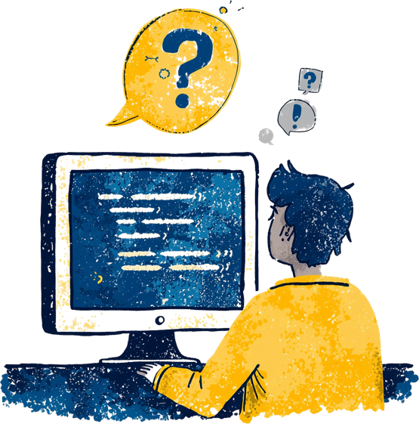
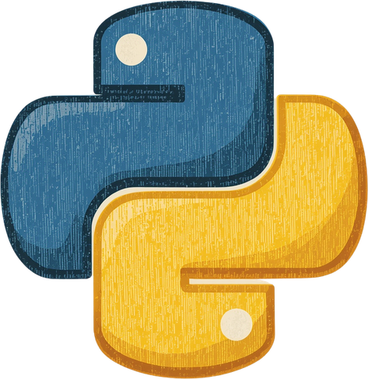
PYTHON
PRESENTATION
HOME
ABOUT
CONTENT
OTHERS
THANK YOU
Thank you for your attention! Questions and discussion are welcome. Feel free to reach out for further information about Python programming.
-

